Slide 1
Arduino project
FIREFIGHTING ROBOT with VOICE CONTROLLED CAR
C.ANKITH KUMAR(2101AI12),R.SAI VARSHITH(2101AI28),D.SAI SRAVANTH(2101AI29)

Slide 2

Working of voice control car:-
We have developed an app that takes in input with the help of a speech recogniser and sends it as a bluetooth signal.
This bluetooth signal is received by a bluetooth module attached to our car robot and works accordingly.
A brief look of the app is as follows:

Slide 3
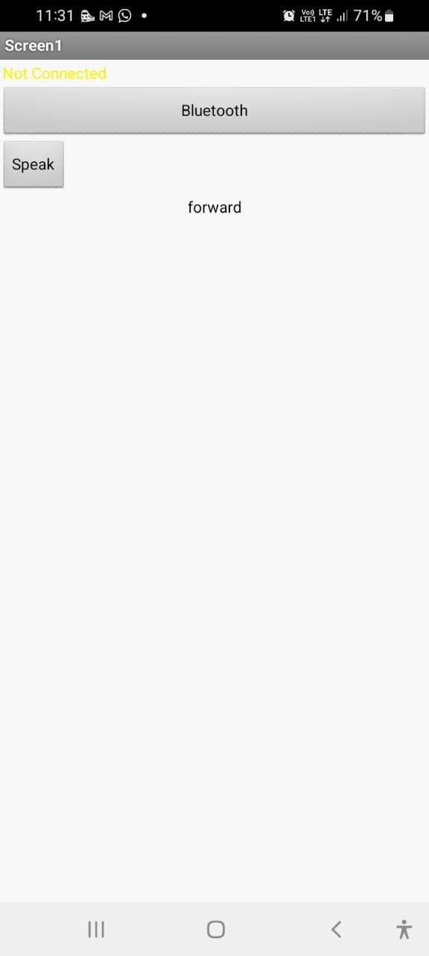
Whenever an instruction is given the app displays the command as follows:
The text in yellow colour indicates whether bluetooth is connected or not.

Slide 4
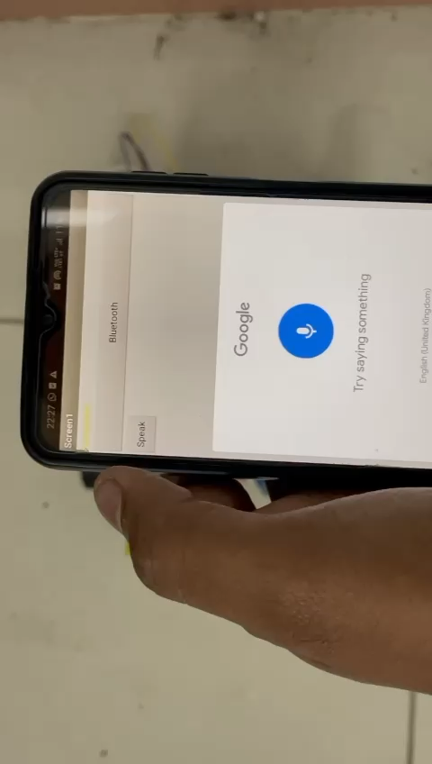
Voice control Demonstration
Forward instruction
Whenever the speech recogniser detects the forward speech, then the car moves as shown

Slide 5

Voice control Demonstration
Back instruction
Whenever the speech recogniser detects the back speech, then the car moves as shown

Slide 6
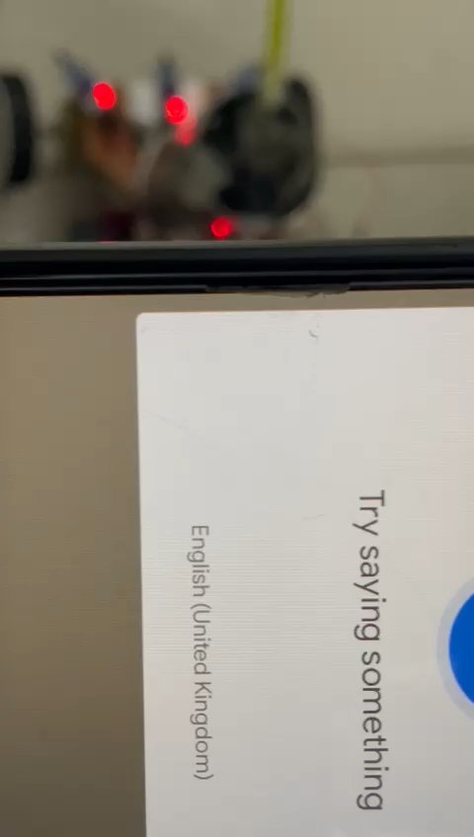
Voice control Demonstration
Right instruction
Whenever the speech recogniser detects the right speech, then the car moves as shown

Slide 7
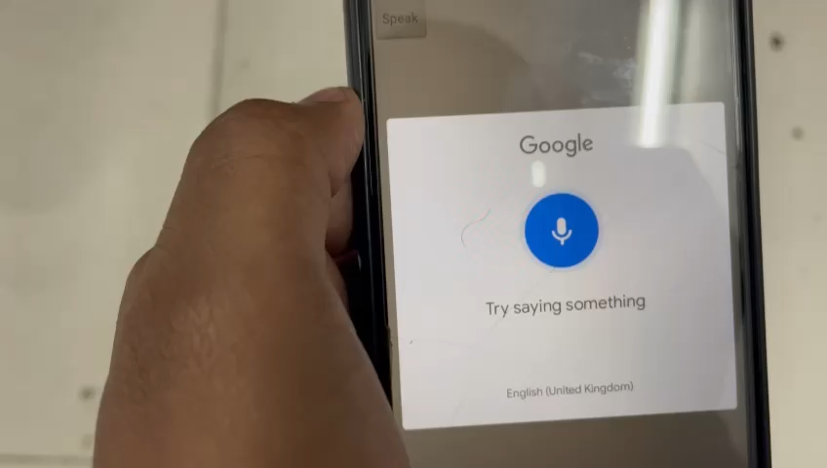
Voice control Demonstration
Left instruction
Whenever the speech recogniser detects the left speech, then the car moves as shown

Slide 8
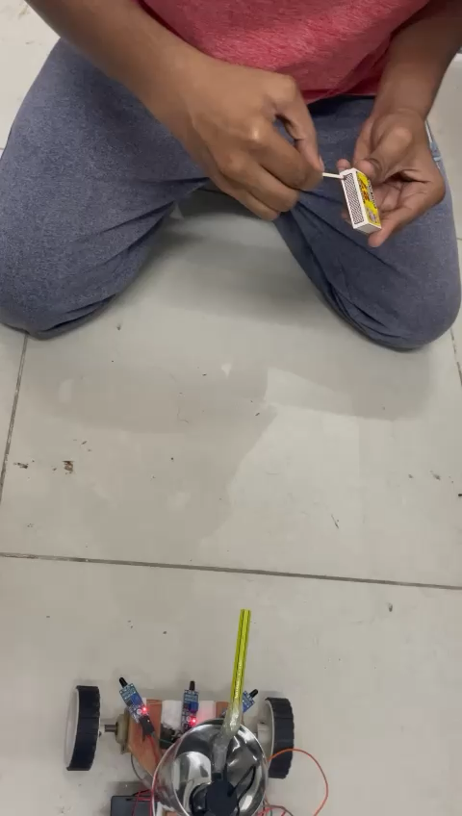
FIRE FIGHTER DEMONSTRATION
WORKING:-
There are three flame sensors on the car, these are responsible for the detection of fire upto a certain distance.
If the left/right sensor detects the flame, then the car turn left/right and then the forward sensor detects the flame and move accordingly.

Slide 9
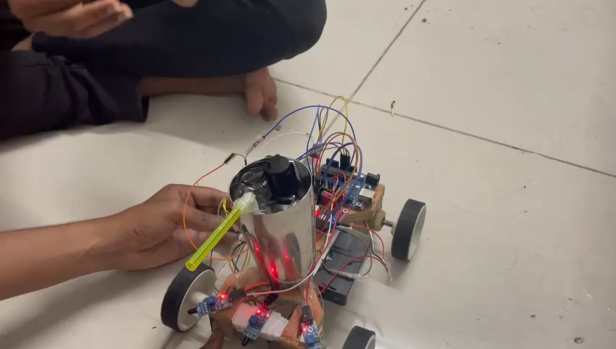
FIRE FIGHTER DEMONSTRATION
Working:-
After the sensor detects fire, the car moves towards the fire and stops a certain distance from the fire,spills water on it as shown.
In the snap shown the car has been held forcefully to show the spillage of water clearly.
In real scenario the fire would be present in a large area and so the car will stop at a certain distance and start spilling out water.

